Slide 1


How to input special characters in Alma
Yoel Kortick
Senior Librarian

Slide 2
Agenda
1
Introduction
2
Copy and Paste
3
Windows built-in “Character Map”
4
Web Browser “add-on”
5
Other Places in Alma

Slide 3
Introduction
Alma is a web-based application. Therefore the the options to add special characters such as diacritics to records are diverse and similar to other web based applications.
When we state here “special characters” we mean characters that are not available via the standard keyboard used by the cataloger.

Slide 4
Introduction
Three options for adding special characters are to:
  Copy and paste
  Use the windows built-in “Character Map”
  Use a web browser “add-on”

Slide 5
Agenda
1
Introduction
2
Copy and Paste
3
Windows built-in “Character Map”
4
Web Browser “add-on”
5
Other Places in Alma

Slide 6
Copy and paste
In the case of “copy and paste” the characters are copied from any web page or windows document.
For example, the cataloger may want to add an alternate title (246) “Handbókin list og hönnun Librarianship”, which is Icelandic for “The handbook of art and design librarianship”
On the keyboard of the cataloger he does not have the option to “type” following letters:
  ó
  ö

Slide 7
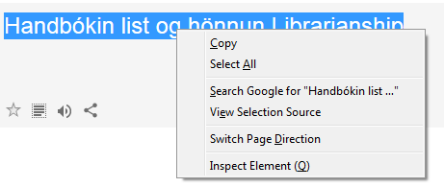
Copy and paste
The cataloger can copy from here (either just the specific letters he needs or the entire string)

Slide 8
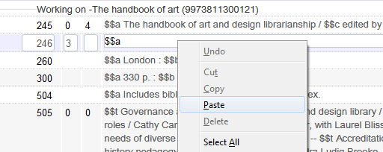
Copy and paste
Then in the metadata editor the cataloger can right click in the desired field and paste

Slide 9
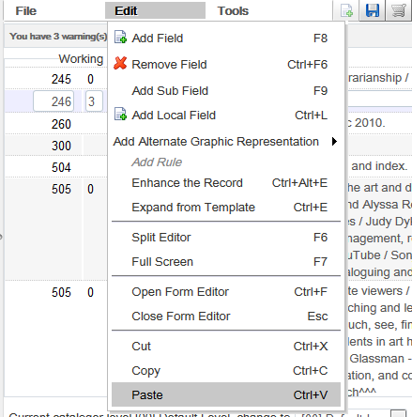
Copy and paste
The cataloger could also use the “edit” menu to paste or use “ctrl+v”

Slide 10
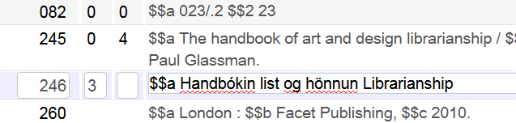
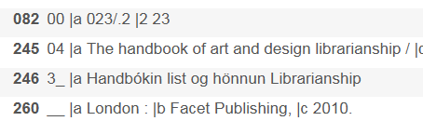
Copy and paste
The characters are added as desired

Slide 11
Agenda
1
Introduction
2
Copy and Paste
3
Windows built-in “Character Map”
4
Web Browser “add-on”
5
Other Places in Alma

Slide 12
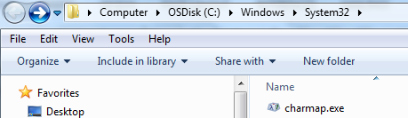
The windows built-in “Character Map”
The windows built-in ‘Character Map’ is typically located under C:\Windows\system32

Slide 13

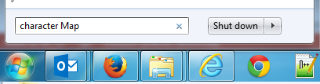
The windows built-in “Character Map”
The ‘Character Map’ can also be accessed by doing “start” and searching for “character map”.

Slide 14
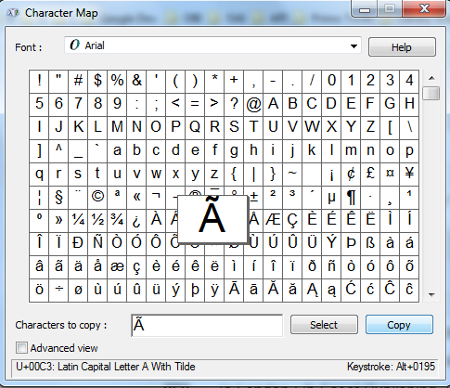
The windows built-in “Character Map”
Any character can be copied from the ‘Character Map’ and then pasted into the metadata editor

Slide 15
The windows built-in “Character Map”
For example, the cataloger may want to add an alternate title (246) “Håndboken for kunst og design bibliotek”, which is Norwegian for “The handbook of art and design librarianship”
On the keyboard of the cataloger he does not have the option to “type” following letter:
  å

Slide 16
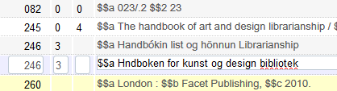
The windows built-in “Character Map”
The cataloger can type what he can with his keyboard and leave (“skip”) the special character å
Then he can put his cursor on the place where it needs to be entered
Missing å. The cursor is here.

Slide 17
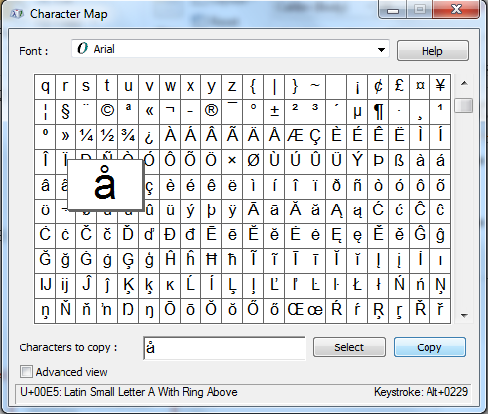
The windows built-in “Character Map”
Here it is copied from the character map

Slide 18
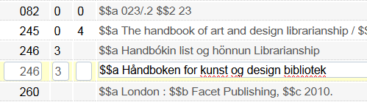
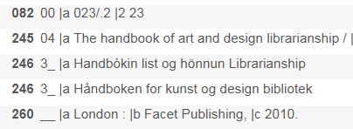
The windows built-in “Character Map”
Then it is pasted to the metadata editor

Slide 19


The windows On Screen Keyboard
In addition to the windows character map there is also a “Windows On Screen keyboard”.
Using the Windows On Screen keyboard requires that you have the specific language installed on your PC but you do not need the special keyboard of that language.
This is not the “recommended method” because it requires that the language is installed. The windows built-in “Character Map” does not require that the language be installed and thus can be used for any language.
The On Screen Keyboard may be accessed via ‘Start > osk’

Slide 20
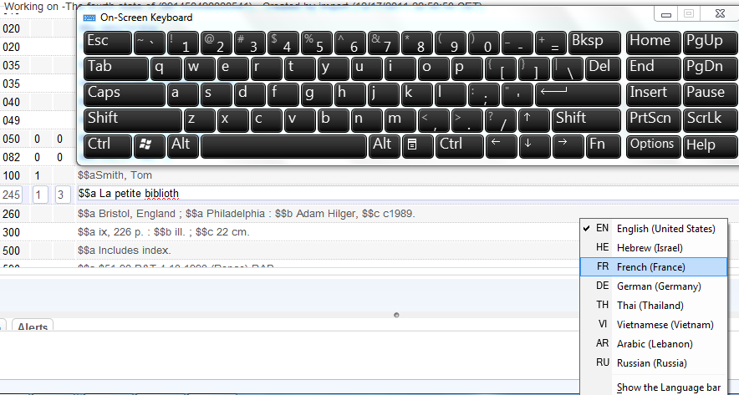
The windows On Screen Keyboard
For example we want to add the French è after ‘biblioth’ in field 245. The keyboard opens in English and we must change the windows to French

Slide 21
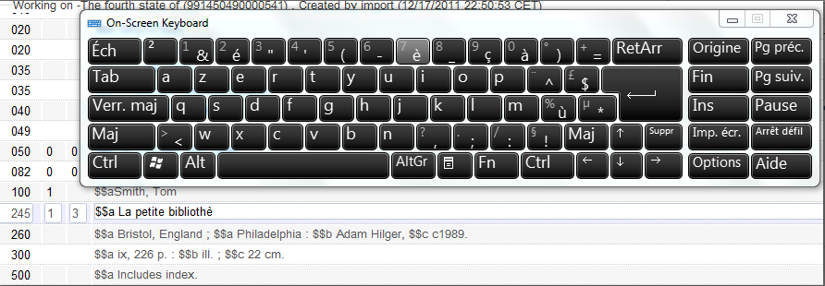
The windows On Screen Keyboard
After switching the Windows to French the French keyboard opens.
We click the è in the keyboard and it gets added in the metadata editor where the cursor was placed.

Slide 22
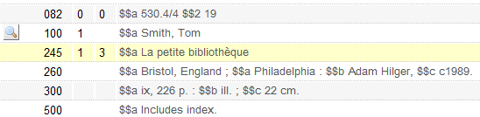
The windows On Screen Keyboard
Now the record is complete

Slide 23
Agenda
1
Introduction
2
Copy and Paste
3
Windows built-in “Character Map”
4
Web Browser “add-on”
5
Other Places in Alma

Slide 24

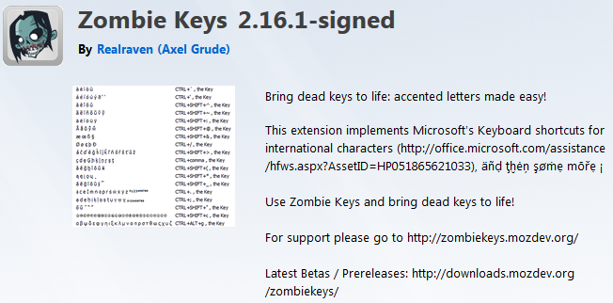
Web Browser Add-On
Another popular method of entering special characters is to use a web browser add-on.
For example in this case we will use ‘Zombie Keys’ for Firefox

Slide 25
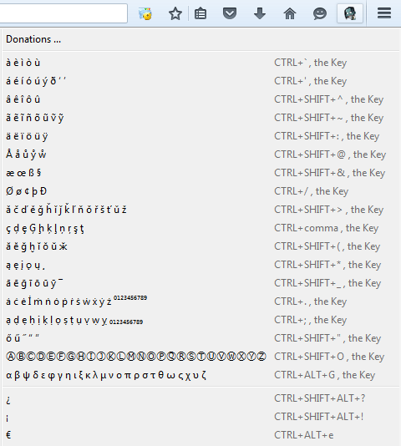
Web Browser Add-On
Now we can enter any of these characters in the metadata editor

Slide 26
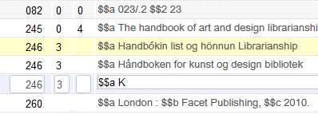
Web Browser Add-On
For example now we want to enter the character ä.
The full text we will enter is “Käsikirja taiteen ja muotoilun kirjastotieteen” in 246 field.
This is Finnish for ”The handbook of art and design librarianship”
First we will enter just the K
ä will be added here

Slide 27
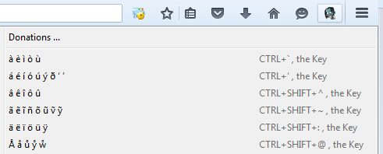
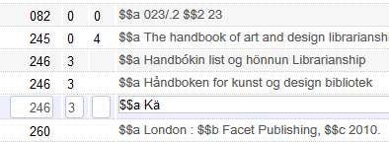
Web Browser Add-On
Using the specified shortcut key the ä has been added
ä has been added here

Slide 28
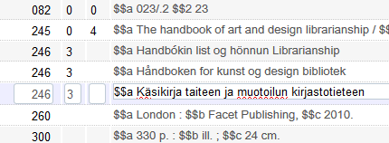
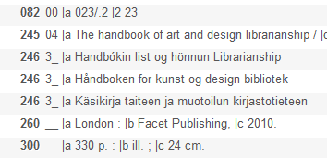
Web Browser Add-On
Now we can add the rest of the field “as normal” and we are done

Slide 29
Agenda
1
Introduction
2
Copy and Paste
3
Windows built-in “Character Map”
4
Web Browser “add-on”
5
Other Places in Alma

Slide 30

Other places in Alma - Vendor
The methods used here for the metadata editor can also be used for other fields in other places in Alma
For example we may have a vendor with name “Knihovna elektronické zdroje po celém světě” (which is Czech for “Library Electronic Resources Worldwide”). The é and ě are not on the specific librarian’s keyboard
It can be copied in windows:

Slide 31
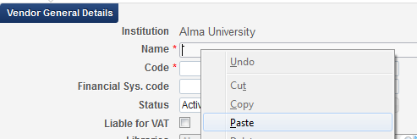


Other places in Alma - Vendor
Then paste the text

Slide 32

Other places in Alma - Patron
In another example we may have a patron with name “Bjørg Smith”. The specific cataloger does not have ø on his keyboard.
After typing ‘Bj’ we can use the shortcut key for Zombie Keys to add the ø

Slide 33
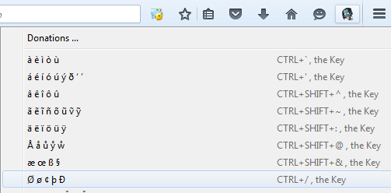

Other places in Alma - Patron

Slide 34
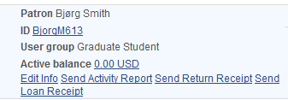
Other places in Alma - Patron

Slide 35
Thank you
Yoel Kortick
Senior Librarian

